Slide 1
Filtration of Simplicial Complexes and Their Application to Mapper Graphs
Fatemeh Shanehsazan
University of Iowa
June 2025

Slide 2
Outline
TDA Mapper Algorithm
Review for Simplicial Complex
Simplicial Map
Filtration of Mapper Graphs

Slide 3
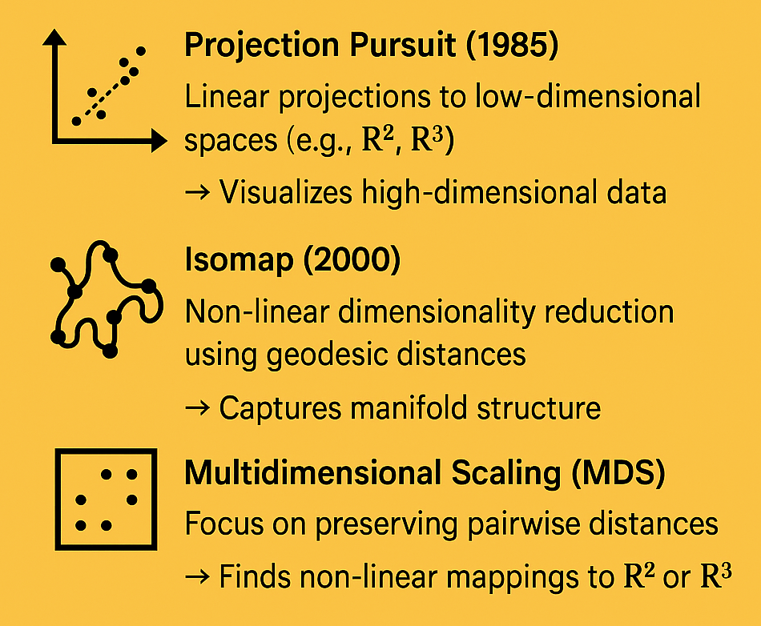
How We Analyzed Complex Data Before TDA Mapper:

Slide 4
Filter Functions in TDA Mapper?
Principal Component: Projects data onto the dominant axis
Density: Uses a Gaussian kernel to estimate local density
Eccentricity: Measures average distance from each point to others

Slide 5
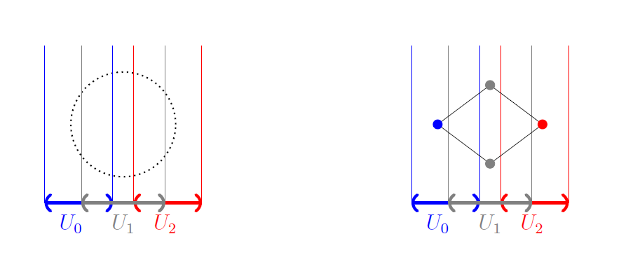
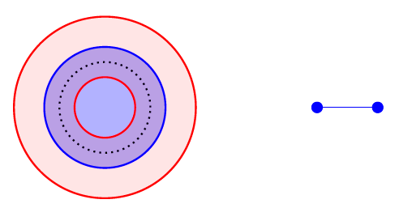


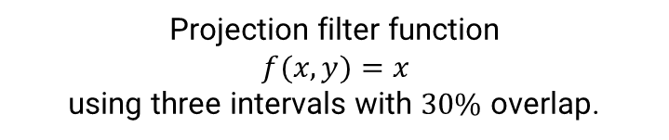


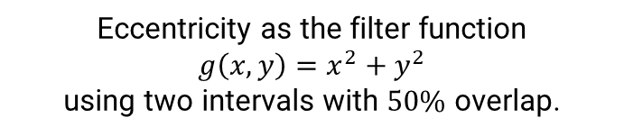



Mapper Example with a projection and eccentricity filter functions
$$f^{−1}(U_{0})$$
$$f^{−1}(U_{1})$$
$$f^{−1}(U_{2})$$
$g^{−1}(U_{1}$)
$g^{−1}(U_{0}$)
$$U_{0}$$
$$U_{1}$$
Projection filter function
$f(x,y)=x_{ }$
using three intervals with $30\%$ overlap.
Eccentricity as the filter function
$g\left(x,y\right)=x^{2}+y^{2}$
using two intervals with $50\%$ overlap.
Bungula, W. T. (2019). PhD thesis, University of Iowa.

Slide 6
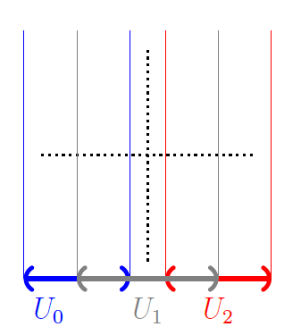
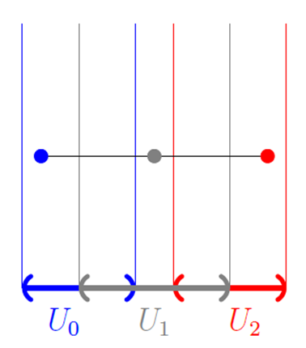
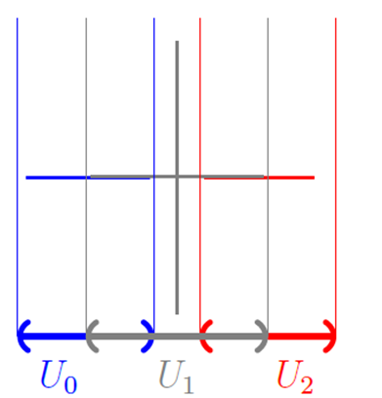
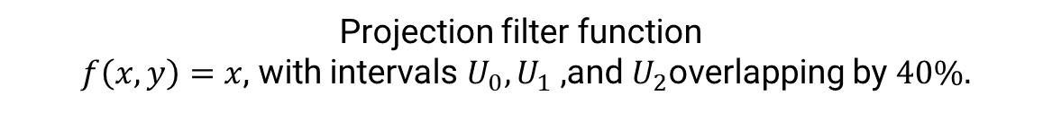
Mapper example with a projection filter function
Projection filter function
$f\left(x,y\right)=x$​, with intervals $U_{0},U_{1}$ ,and $U_{2}$overlapping by $40\%.$
Bungula, W. T. (2019). PhD thesis, University of Iowa.

Slide 7
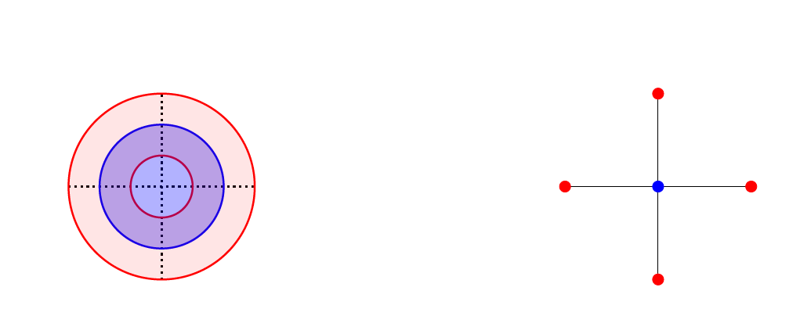
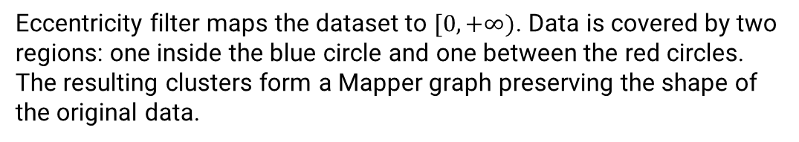
Mapper Example with eccentricity filter function
Eccentricity filter maps the dataset to $[0,+∞)$. Data is covered by two regions: one inside the blue circle and one between the red circles. The resulting clusters form a Mapper graph preserving the shape of the original data.
Bungula, W. T. (2019). PhD thesis, University of Iowa.

Slide 8
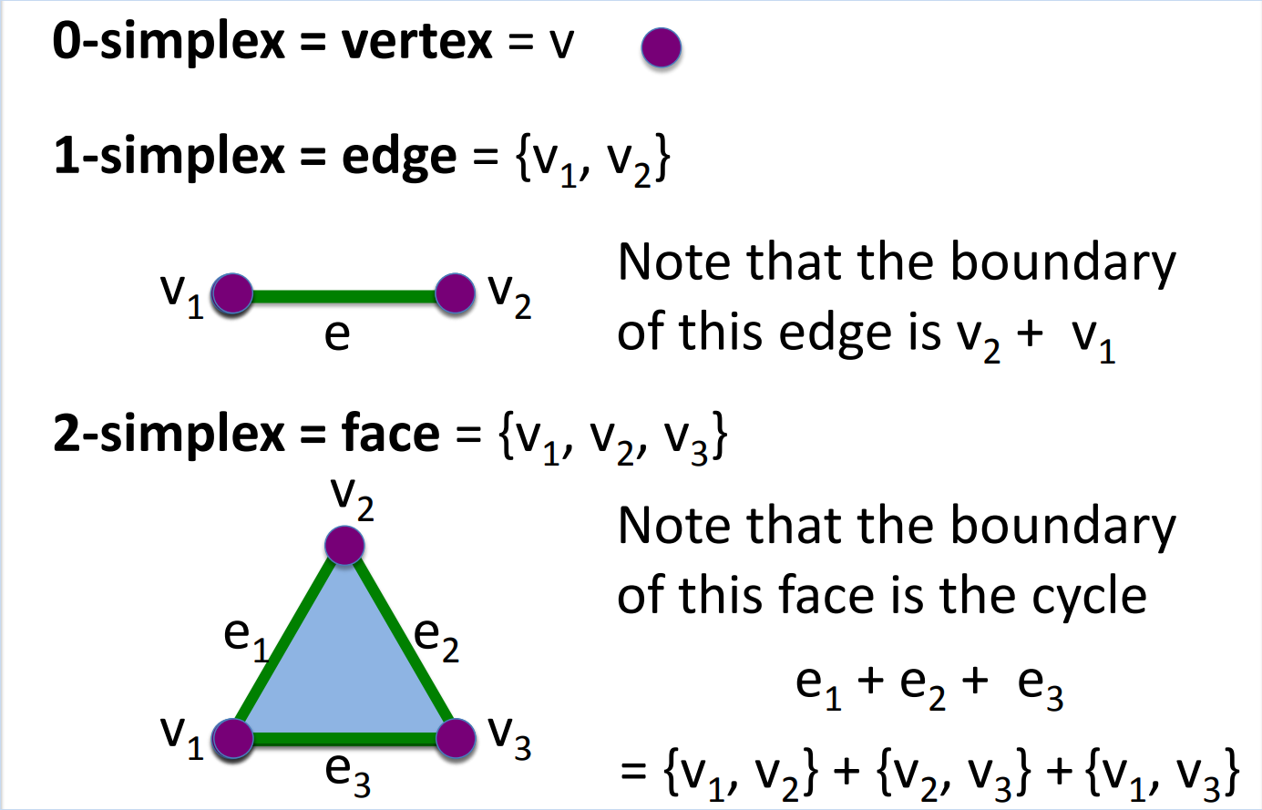
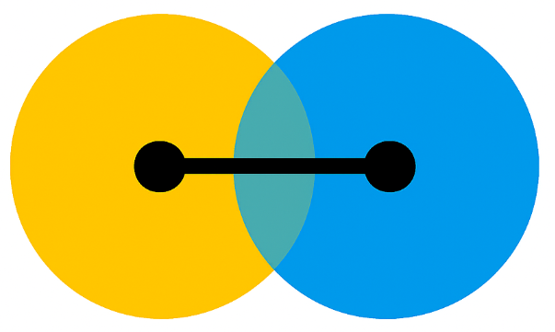

Review: 0-, 1-, and 2-Simplices
https://homepage.math.uiowa.edu/~idarcy/AT/prelectures.html

Slide 9
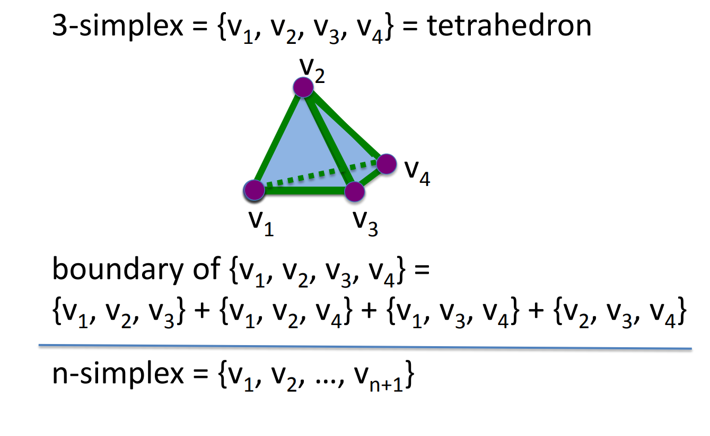
Review: 3-Simplex and n-Simplex
https://homepage.math.uiowa.edu/~idarcy/AT/prelectures.html

Slide 10
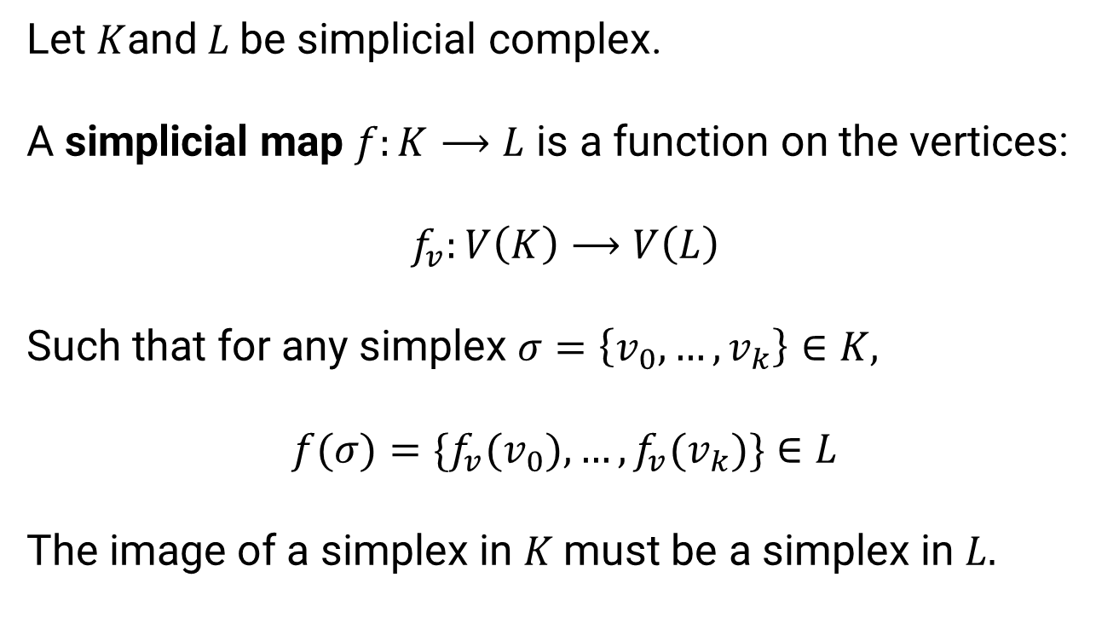
Definition of a Simplicial Map
Let $K$and$L$be simplicial complex.
A simplicial map $f:K⟶L$ is a function on the vertices:
$$f_{v}:V\left(K\right)⟶V\left(L\right)$$
Such that for any simplex $σ=\left\{v_{0},…,v_{k}\right\}∈K,$
$$f(σ)=\{f_{v}(v_{0}),…,f_{v}(v_{k})\}∈L$$
The image of a simplex in $K$must be a simplex in $L.$

Slide 11
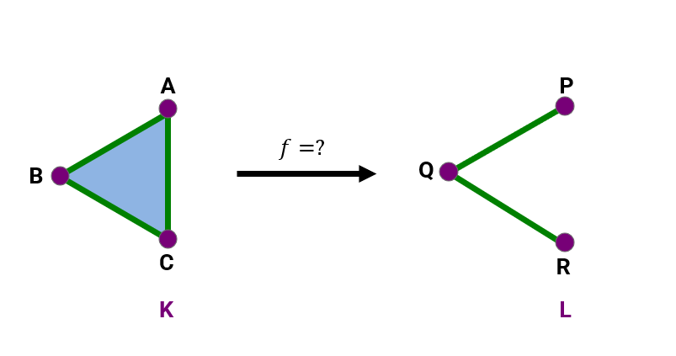
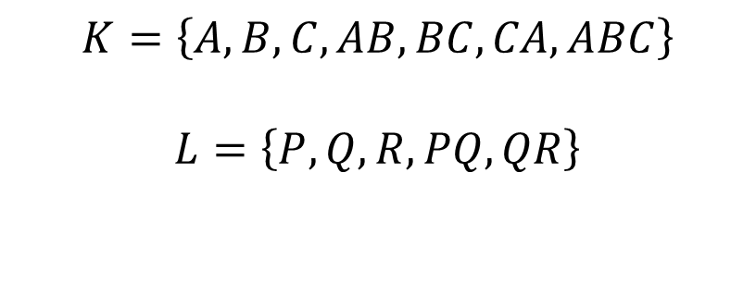

Example: Can We Define a Simplicial Map?
$$K=\left\{A,B,C,AB,BC,CA,ABC\right\}$$
$$L=\left\{P,Q,R,PQ,QR\right\}$$
$$f= ?$$

Slide 12
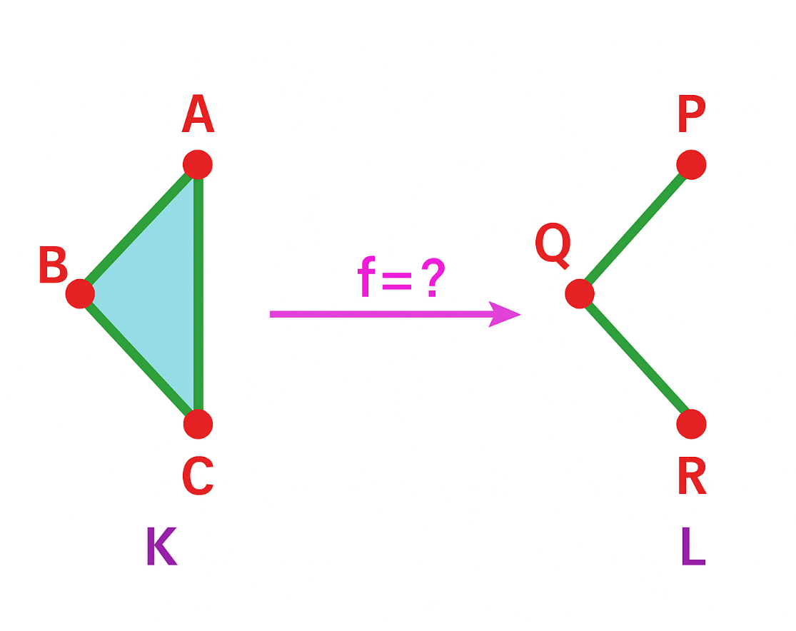
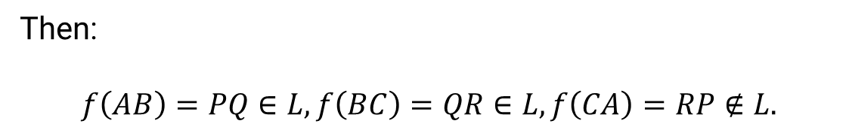


First Attempt: Injective Vertex Map
$$f= ?$$
$$f\left(A\right)=P, f\left(B\right)=Q, f\left(C\right)=R.$$
Then:
$$f\left(AB\right)=PQ∈L, f\left(BC\right)=QR∈L, f\left(CA\right)=RP∉L.$$

Slide 13



Second Attempt: Collapse One Vertex
$$f= ?$$
$$f\left(A\right)=P, f\left(B\right)=Q, f\left(C\right)=Q.$$
Then:
$$f\left(AB\right)=PQ∈L, f\left(BC\right)=Q∈L, f\left(CA\right)=Q∈L.$$

Slide 14
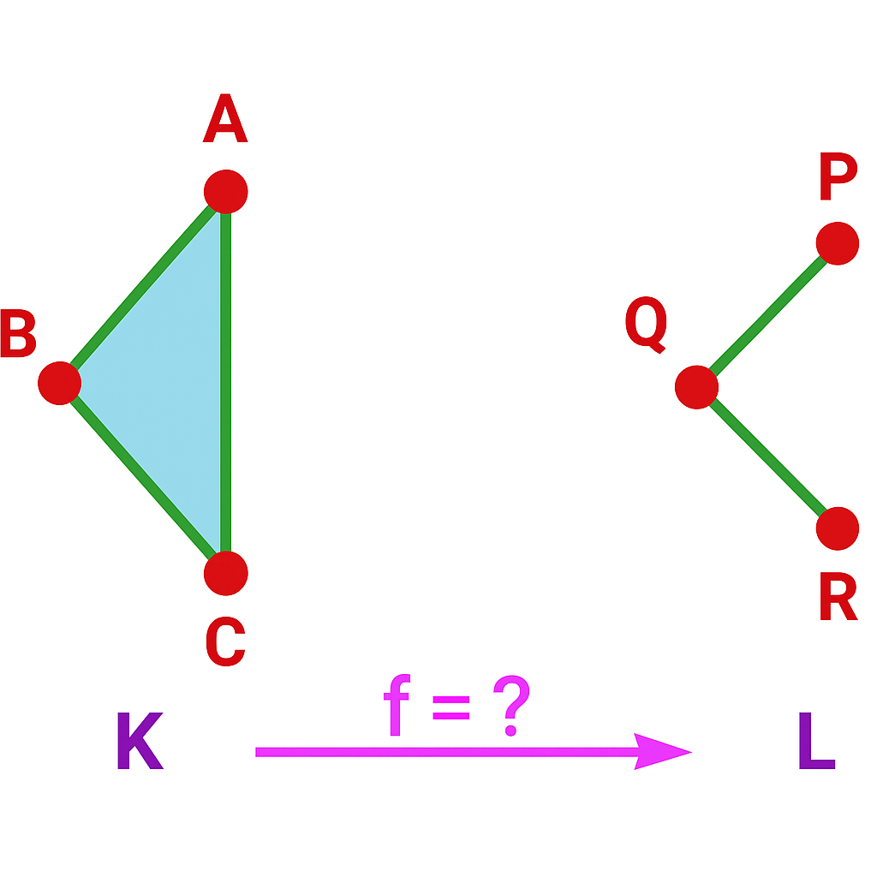

Simplicial Map with Collapse
A
A
P
B
Q
R
C
K
L
$f\left(ABC\right)=PQ∈$ L

Slide 15
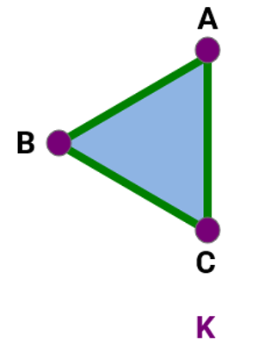
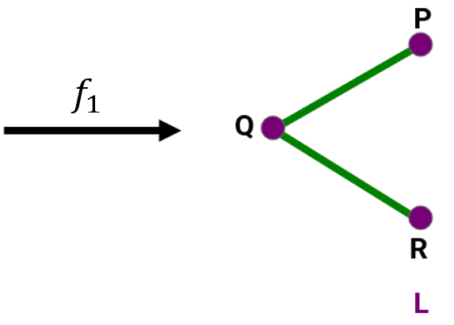
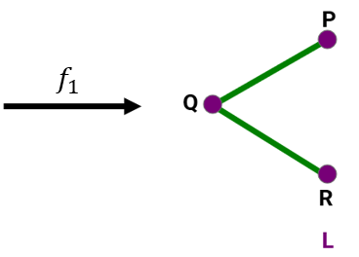

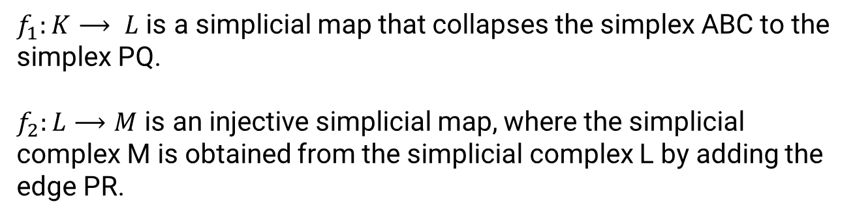
Filtration= A sequence of simplicial maps
$$f_{2}$$
M
$f_{1}:K⟶ L$ is a simplicial map that collapses the simplex ABC to the simplex PQ.
$f_{2}:L⟶M$ is an injective simplicial map, where the simplicial complex M is obtained from the simplicial complex L by adding the edge PR.

Slide 16
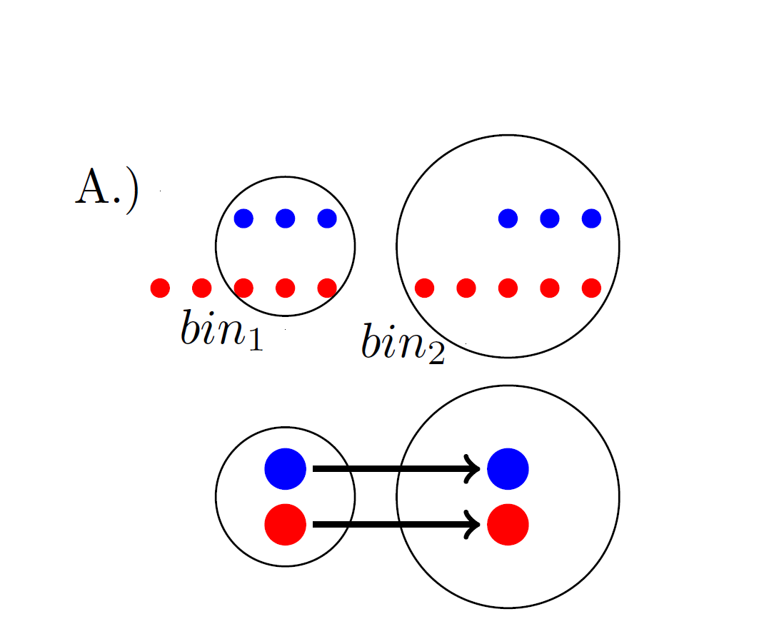




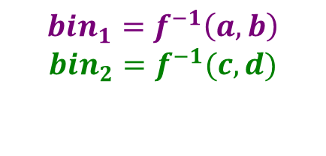

Filtration Behavior in Mapper Graphs as Bin Size Increases
$$bin_{1}=f^{−1}\left(a,b\right)$$
$$bin_{2}=f^{−1}(c,d)$$
$$c$$
$$a$$
$$b$$
$$d$$
When the bin size increases (i.e.,$bin_{1}\text{⊆} bin_{2}$ ), the blue cluster stays the same, the red cluster grows, and both nodes in the Mapper graph remain unchanged.
Bungula, W. T. (2019). PhD thesis, University of Iowa.

Slide 17
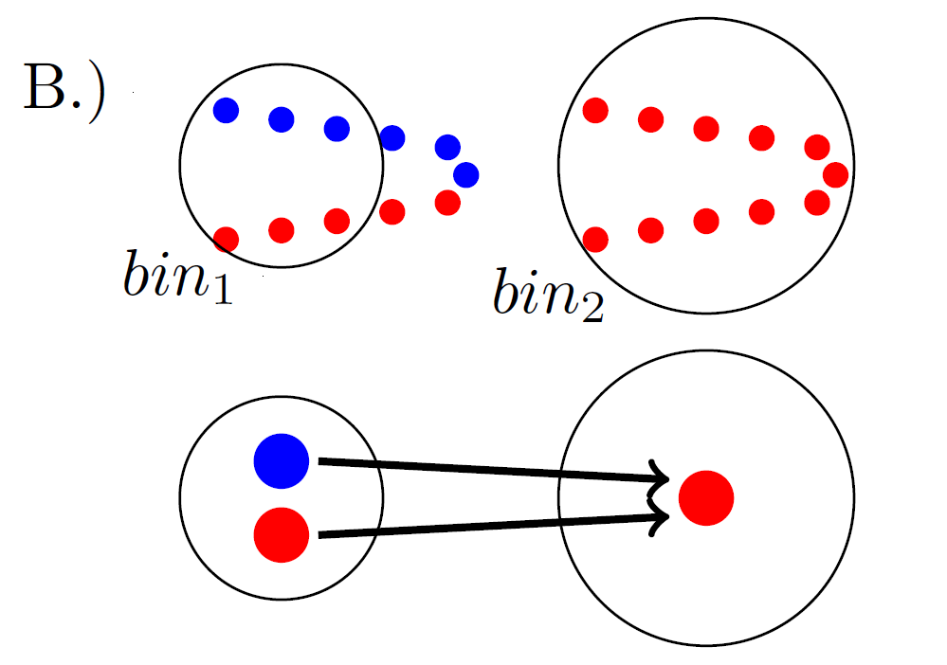
Filtration Behavior in Mapper Graphs as Bin Size Increases
As bin size increases ($bin_{1}⊆bin_{2}$), the red and blue clusters merge into one red cluster, and their corresponding nodes in the Mapper graph also merge.
Bungula, W. T. (2019). PhD thesis, University of Iowa.

Slide 18
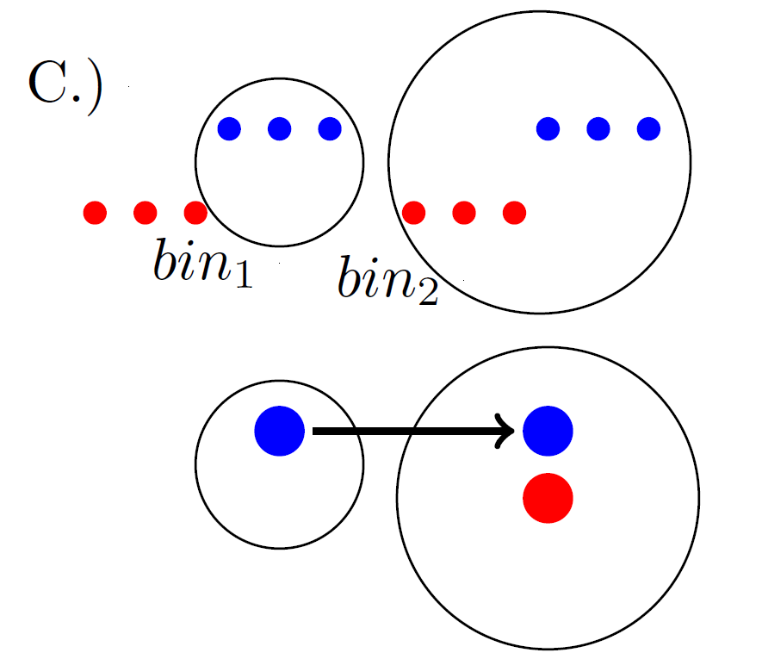
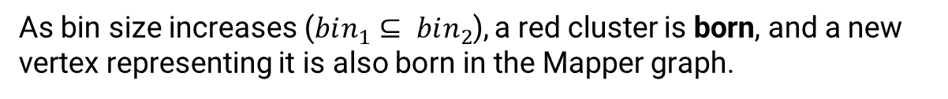


Filtration Behavior in Mapper Graphs as Bin Size Increases
$$G_{1}$$
$$G_{2}$$
As bin size increases ($bin_{1}⊆ bin_{2}$), a red cluster is born, and a new vertex representing it is also born in the Mapper graph.
Bungula, W. T. (2019). PhD thesis, University of Iowa.

Slide 19
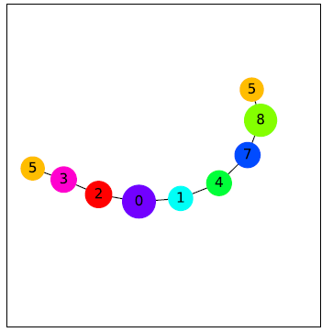
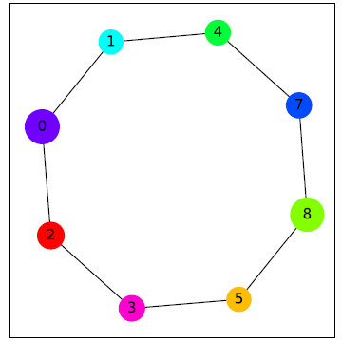
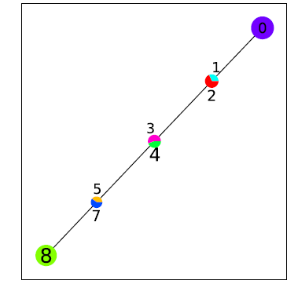
Future directions
Create software for visualizing the filtration of mapper graphs
Apply persistent homology to the filtration of mapper graphs.
Rooke, E. A. (2023). PhD thesis, University of Iowa.

Slide 20
Acknowledgement
We gratefully acknowledge the use of:
Bungula, W. T. (2019). Bi-filtration and Stability of TDA Mapper for Point Cloud Data (Doctoral dissertation, University of Iowa). Available from ProQuest Dissertations & Theses @ University of Iowa. Retrieved from https://www.proquest.com/dissertations-theses/bi-filtration-stability-tda-mapper-point-cloud/docview/13885666
Bungula, W. T., & Darcy, I. (2024). Bi-filtration and Stability of TDA Mapper for Point Cloud Data. arXiv preprint. https://arxiv.org/abs/2409.17360
Darcy, I. A Terse Introduction to Oriented Simplicial Complexes (lecture notes). Retrieved from https://homepage.math.uiowa.edu/~idarcy/AT/prelectures.html
Rooke, E. A. (2023). On the Efficient Implementation and Parameter Selection for TDA Mapper (Doctoral dissertation, University of Iowa). Available from ProQuest Dissertations & Theses @ University of Iowa. Retrieved from https://www.proquest.com/dissertations-theses/on-efficient-implementation-parameter-selection/docview/2861573370/se-2

Slide 21
Thank You

