Slide 1
KEPLERMAPPER
TDV workshop
Mona Hardani
June 2025
Mona.t.hardani@gmail.com

Slide 2
Brief explanation:
KeplerMapper is a Python library used for visualizing high-dimensional data using the Mapper algorithm from Topological Data Analysis (TDA).
KeplerMapper is part of the scikit-learn TDA package:
https://docs.scikit-tda.org/en/latest/
Official site: https://kepler-mapper.scikit-tda.org/en/latest/
Mona Hardani Mona.t.hardani@gmail.com

Slide 3
Installation:
Install KeplerMapper with pip:
pip install kmapper
Official site: https://keplermapper.scikittda.org/en/latest/started.html#setup
Mona Hardani Mona.t.hardani@gmail.com

Slide 4
Python code
# Import the class
import kmapper as km
# Some sample data
from sklearn import datasets data, labels = datasets.make_circles(n_samples=5000, noise=0.03, factor=0.3)
# Initialize
mapper = km.KeplerMapper(verbose=1)
# Fit to and transform the data
projected_data = mapper.fit_transform(data, projection=[0,1]) # X-Y axis
# Create a cover with 10 elements
cover = km.Cover(n_cubes=10)
# Create dictionary called 'graph' with nodes, edges and meta-information
graph = mapper.map(projected_data, data, cover=cover)
# Visualize it
mapper.visualize(graph,path_html="make_circles_keplermapper_output.html",
title="make_circles(n_samples=5000, noise=0.03, factor=0.3)")
Mona Hardani Mona.t.hardani@gmail.com

Slide 5
1D vs. 2D Lens Function:
What Is a Lens Function?
A lens function maps high-dimensional data to a lower-dimensional space (usually ℝ or ℝ²).
Source : Topological methods for the analysis of high dimensional data sets and 3D object recognition (2007).
Mona Hardani Mona.t.hardani@gmail.com

Slide 6
What is a 1D lens?
Projects data to one dimension (e.g., height, density, first PCA coordinate).
Divides the data range into overlapping intervals.
Mona Hardani Mona.t.hardani@gmail.com

Slide 7
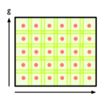
What is a 2D lens?
Projects data onto two dimensions (e.g., PCA1 vs. PCA2,
t-SNE)
Covers ℝ² with overlapping rectangular patches.
Great for capturing complex topological features like loops, holes, or multiple clusters.
Mona Hardani Mona.t.hardani@gmail.com

Slide 8
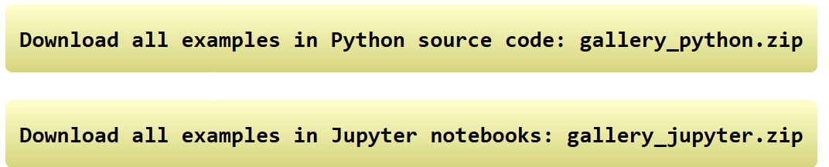
The Jupyter Notebook version of the code:
https://kepler-mapper.scikit-tda.org/en/latest/notebooks/KeplerMapper-usage-in-Jupyter-Notebook.html
See more examples here:
https://kepler-mapper.scikit-tda.org/en/latest/examples.html
Click on:
Mona Hardani Mona.t.hardani@gmail.com

Slide 9
Thank you
Mona Hardani Mona.t.hardani@gmail.com

