Slide 1


Comparing and Tracking Topological Structures via Optimal Transport
TDV Workshop at the University of Iowa
Mingzhe Li
Jun 10, 2025

Slide 2
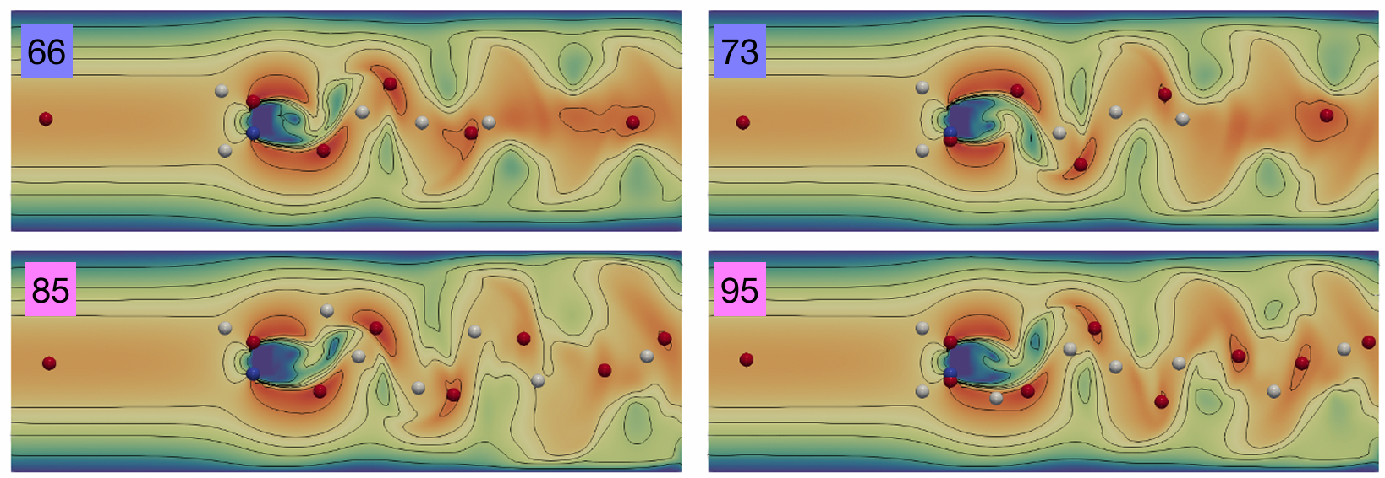
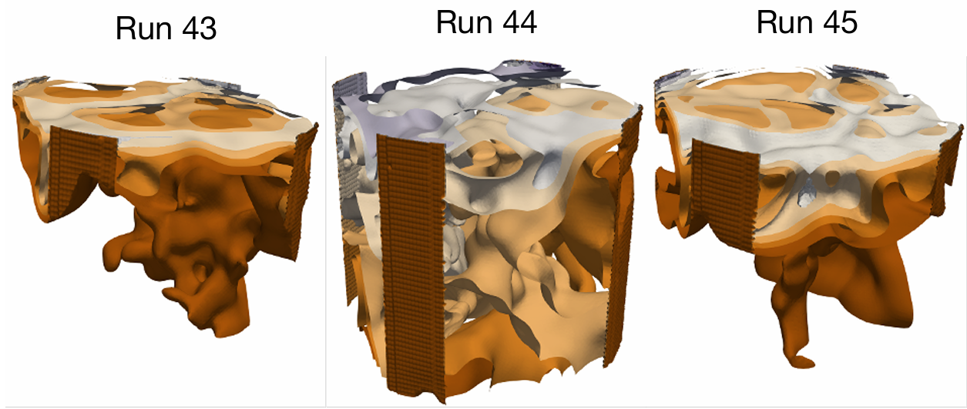
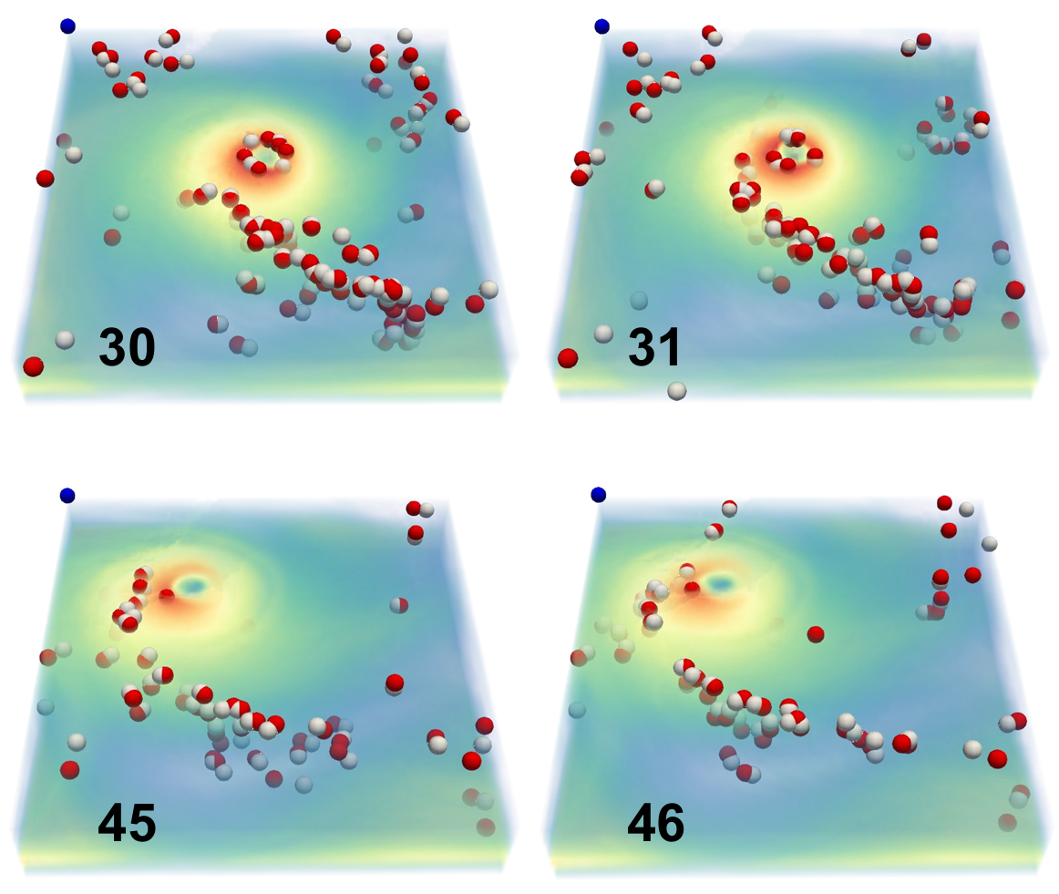
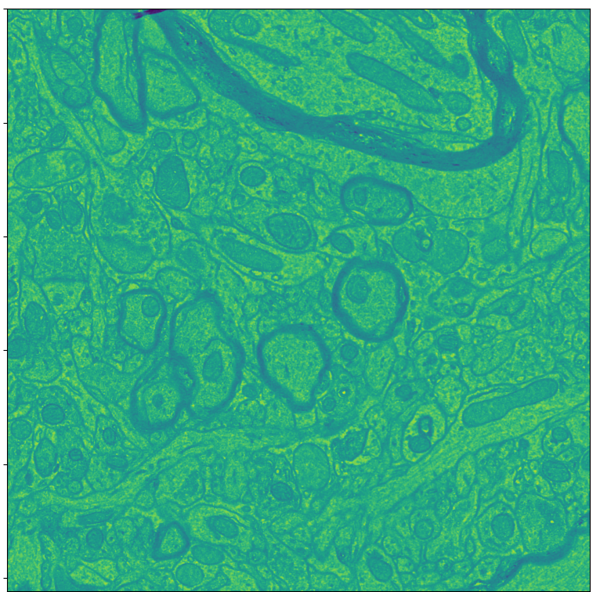
Scalar Field Data
Time-varying
Ensemble
Comparing scalar fields for data analysis
Time-varying flow simulation
3D transient fluid flow simulation
Lyu et al. 2024
3D Isabel Hurricane
P60 Mouse Cortex

Slide 3
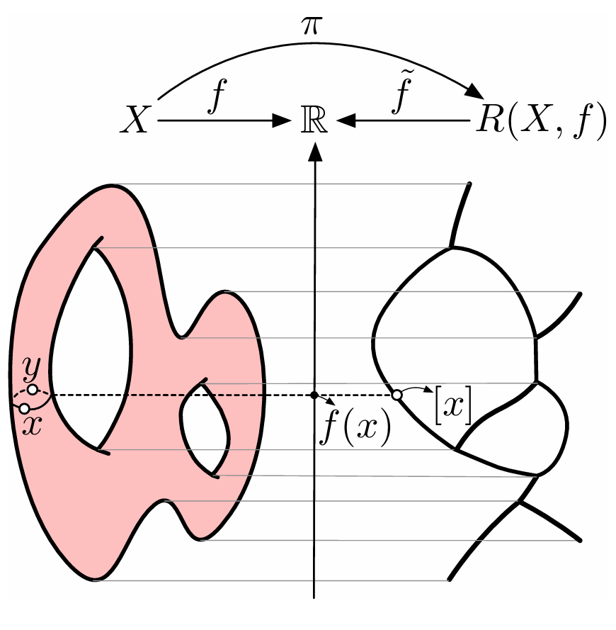
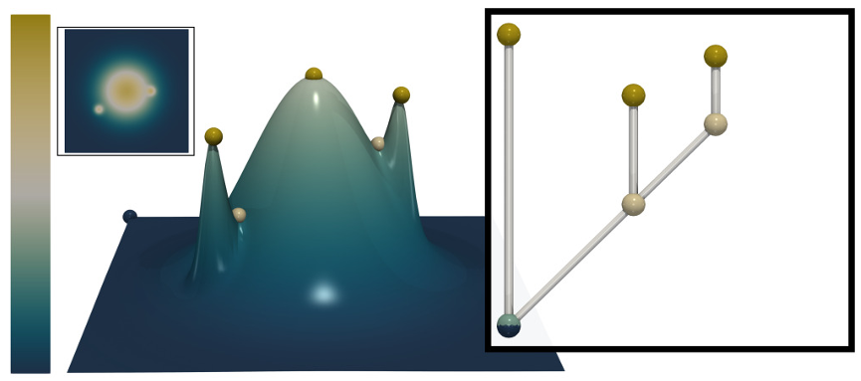
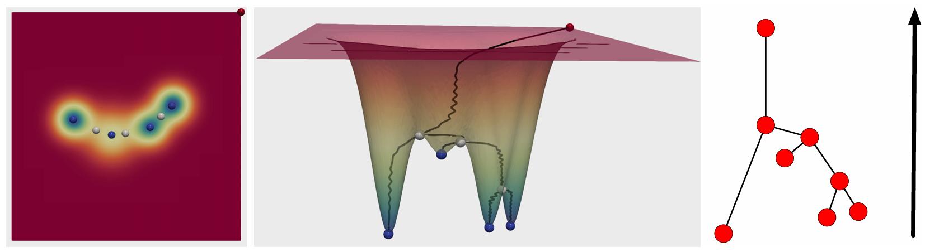
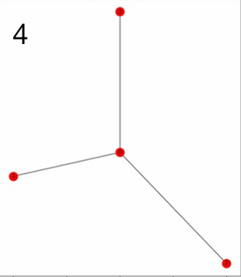
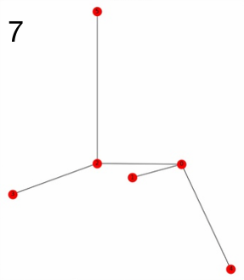
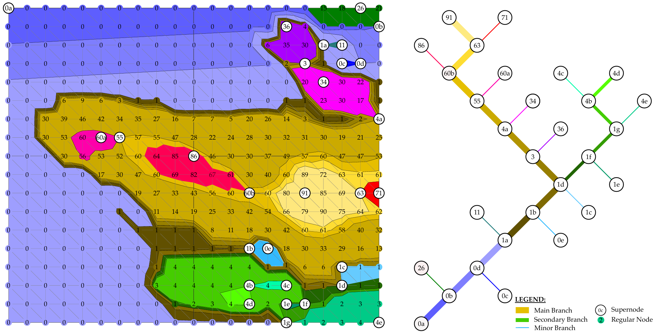
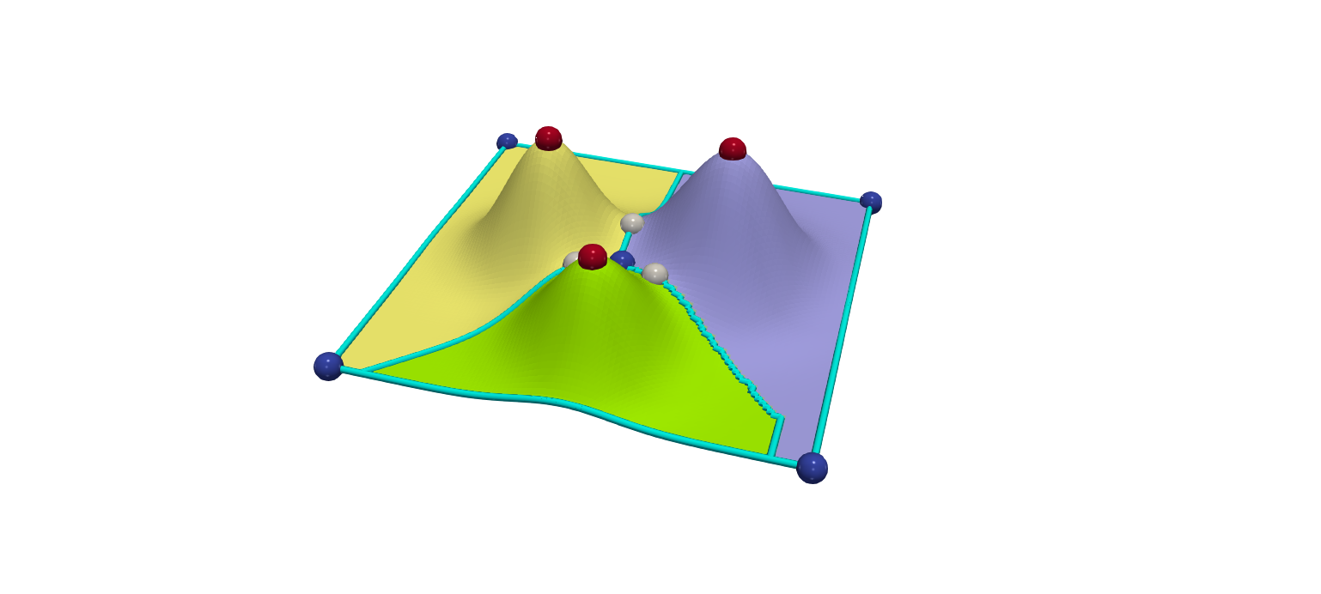
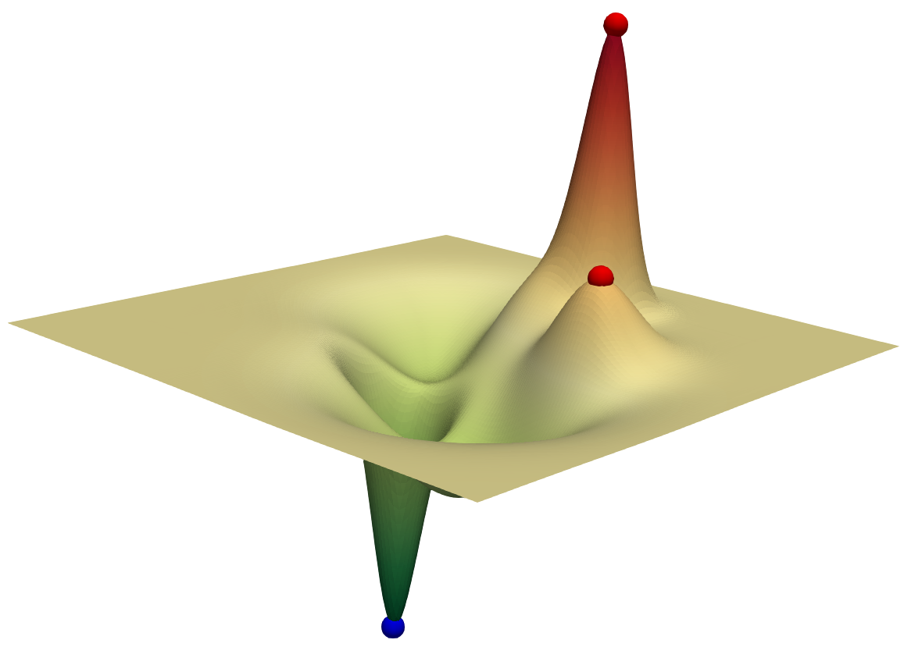
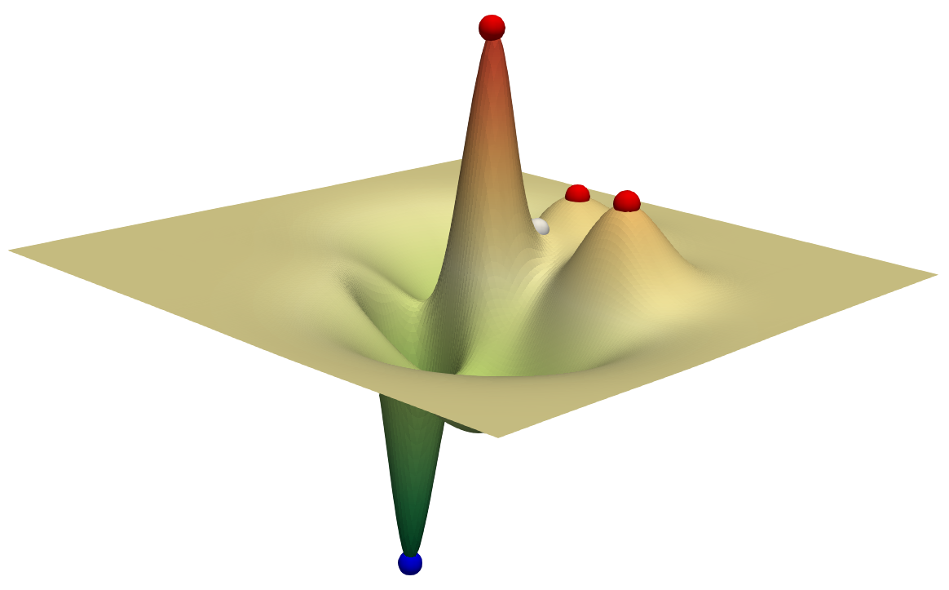
Topological Descriptors
Comparing topological descriptors
2 leaves
3 leaves
Persistence Diagram
Sisouk et al. 2023
Merge Tree
Reeb Graph
Wang et al. 2024
Comparing scalar fields
2 local maxima
3 local maxima
Morse Complex
Contour Tree

Slide 4
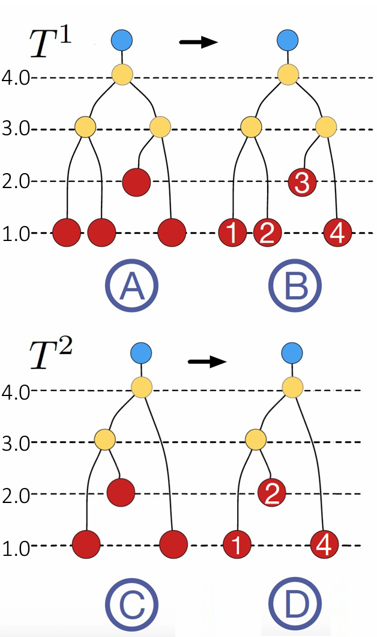
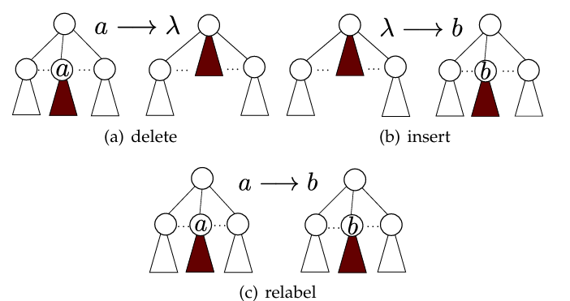
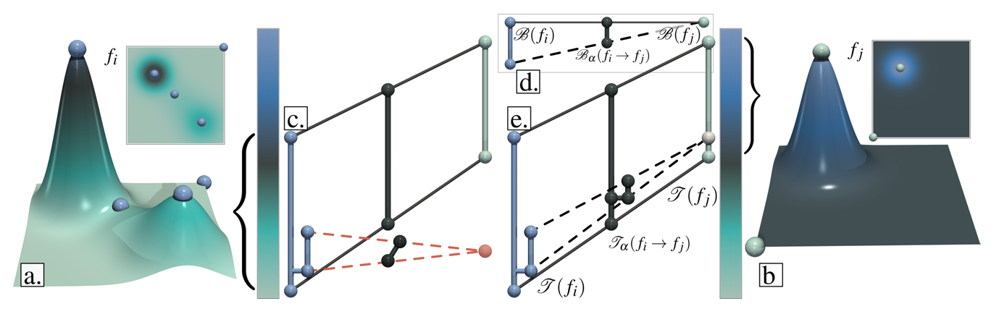
Comparing Topological Descriptors
Problems:
Some are NP-hard
Some require additional restriction / labeling for computation
No existing extension to Morse complexes
Merge Tree Edit Distance
Sridharamurthy et al. 2018
Interleaving Distance
for Labeled Merge Trees
Yan et al. 2021
Merge Tree Wasserstein Distance
Pont et al. 2021

Slide 5
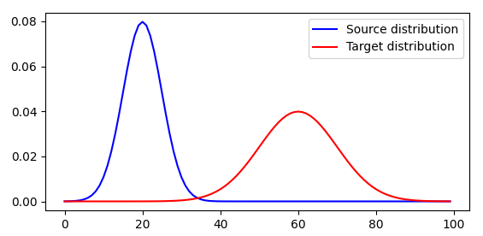
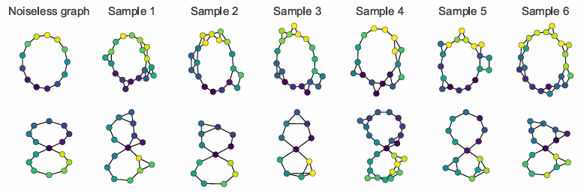
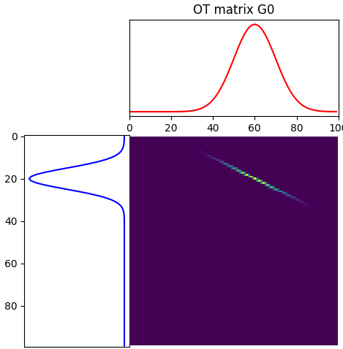
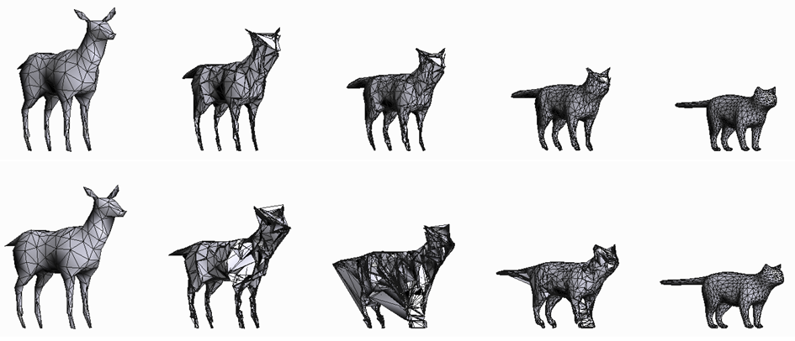
Optimal Transport (OT)
POT documentation
Flamary et al.
Graph matching and shape matching
Vayer et al. 2019
Coupling matrix

Slide 6
Sketching Merge Trees for Scientific Visualization
Mingzhe Li, Sourabh Palande, Lin Yan, Bei Wang
In IEEE Workshop on Topological Data Analysis and Visualization (TopoInVis) at IEEE VIS, 2023.

Slide 7
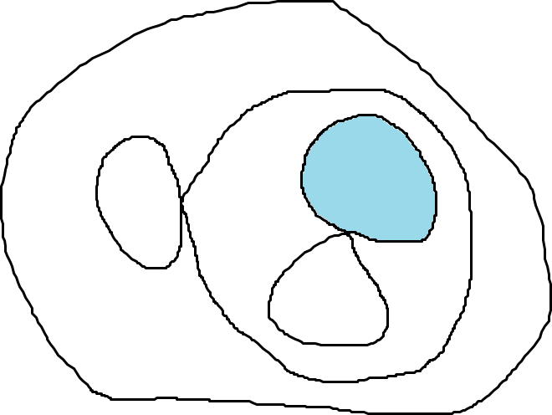
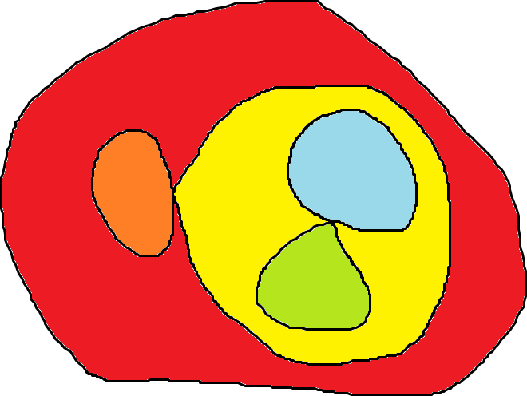
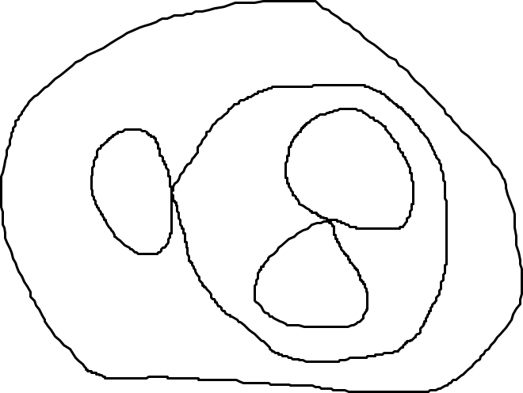
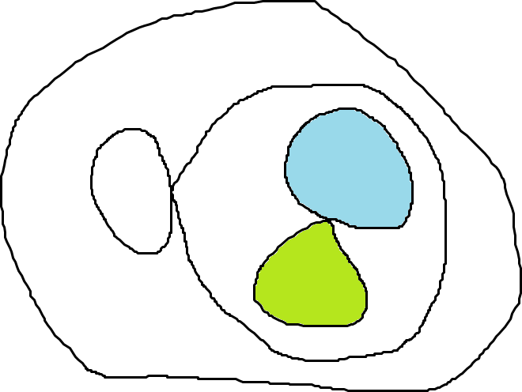
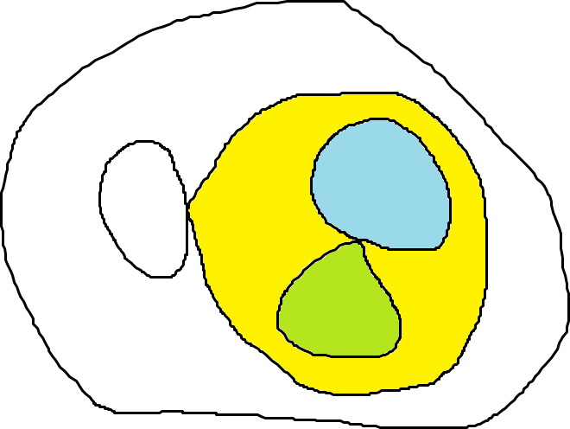
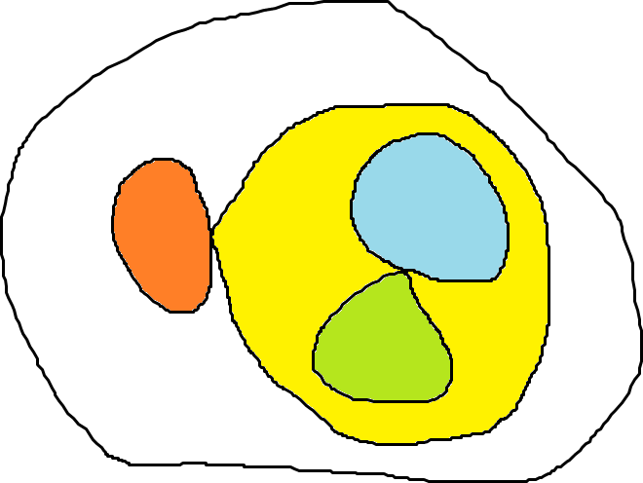


minima
Merge Tree
saddle
$$f$$
maxima
$$a$$

Slide 8
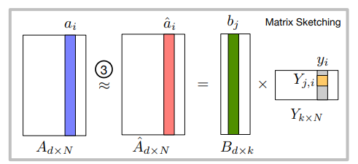


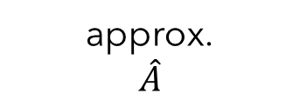



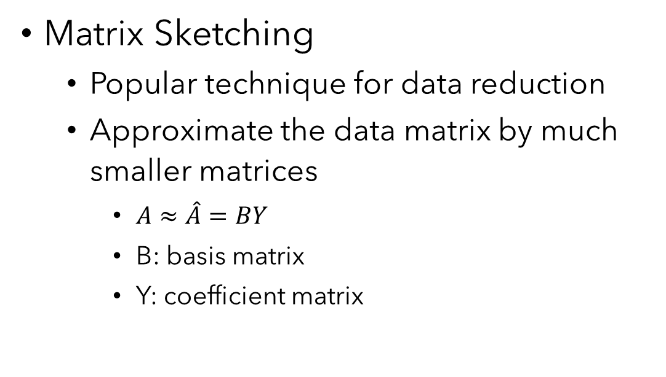

Motivation
data
$$A$$
approx.
$$\hat{A}$$
basis
$$B$$
coefficient
$$Y$$
Matrix Sketching
  Popular technique for data reduction
  Approximate the data matrix by much smaller matrices
    $A≈\hat{A}=BY$
    B: basis matrix
    Y: coefficient matrix
$$≈$$
$$=$$
$$∙$$
representative vector
of original data

Slide 9
Highlight and Contribution
Gromov-Wasserstein (GW) distance between merge trees
  Based on optimal transport
A novel framework to sketch merge trees based on GW distance
  Vectorizing merge trees
  Finding representatives of data
  Identifying modes of physical phenomena

Slide 10
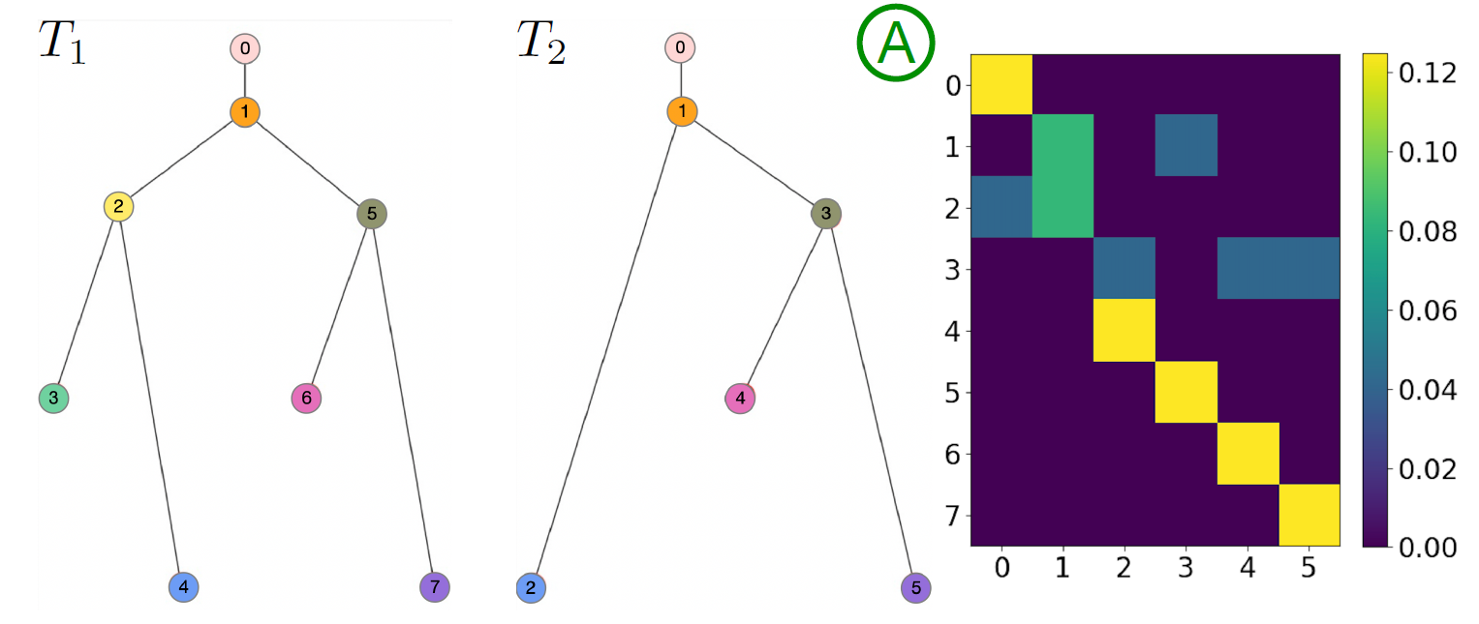




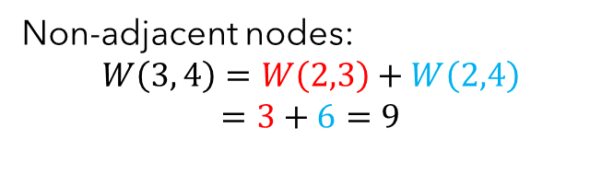



Background: Gromov-Wasserstein Distance
Merge tree as measure networks
  $T=(V, p, W)$
    $V$: a set of nodes
    $p$: a probability distribution on $V$
    $W$: pairwise relation between nodes
Example:
  $V=\{v_{0},v_{1},v_{2},v_{3},v_{4},v_{5},v_{6},v_{7}\}$
  $p=\{\frac{1}{8},\frac{1}{8},\frac{1}{8},\frac{1}{8},\frac{1}{8},\frac{1}{8},\frac{1}{8},\frac{1}{8}\}$
  $W∈R^{8×8}$: shortest path distance
$$0$$
$$1$$
$$3$$
$$6$$
Adjacent nodes:
$$W\left(2, 3\right)=\left|3−6\right|=3$$
Non-adjacent nodes:
$$W\left(3, 4\right)=W\left(2,3\right)+W\left(2,4\right)$$
$$=3+6=9$$
$$9$$

Slide 11




Background: Gromov-Wasserstein Distance
Let $T_{1}=(V_{1}, p_{1}, W_{1})$ and $T_{2}=(V_{2}, p_{2}, W_{2})$ be two merge trees
A coupling $C∈R^{\left|V_{1}\right|×\left|V_{2}\right|}$ is a joint probability measure
  $\sum_{i, j}{C_{i,j}=1}$
  $C1_{|V_{2}|}=p_{1}$
  $C^{T}1_{|V_{1}|}=p_{2}$
$$C∈R^{8×6}$$
For each row, $sum=1/8$
$$1_{n}={\left(1, 1, …, 1\right)}^{T}∈R^{n}$$
For each column, $sum=1/6$
8 nodes
6 nodes
11

Slide 12
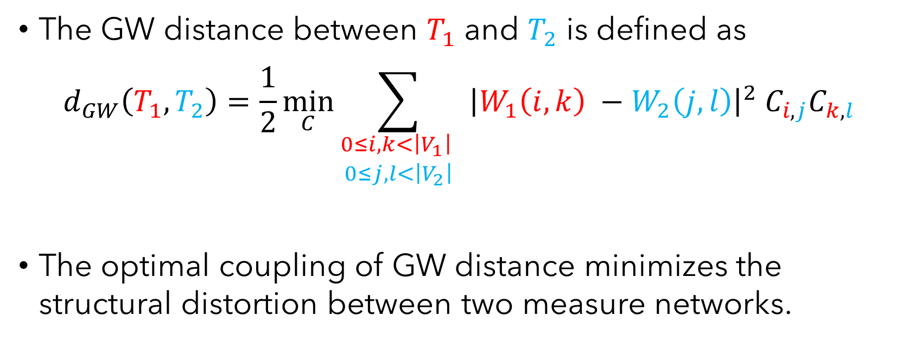
Background: Gromov-Wasserstein Distance
The GW distance between $T_{1}$ and $T_{2}$ is defined as
$$d_{GW}\left(T_{1},T_{2}\right)=\frac{1}{2}\min_{C}{\sum_{\begin{aligned}0≤i, k<\left|V_{1}\right| \\ 0≤j, l<\left|V_{2}\right|\end{aligned}}{ {\left|W_{1}\left(i, k\right) −W_{2}\left(j, l\right)\right|}^{2}{ C}_{i, j}C_{k, l} }}$$
The optimal coupling of GW distance minimizes the structural distortion between two measure networks.
Structural Distortion
Mémoli 2011

Slide 13
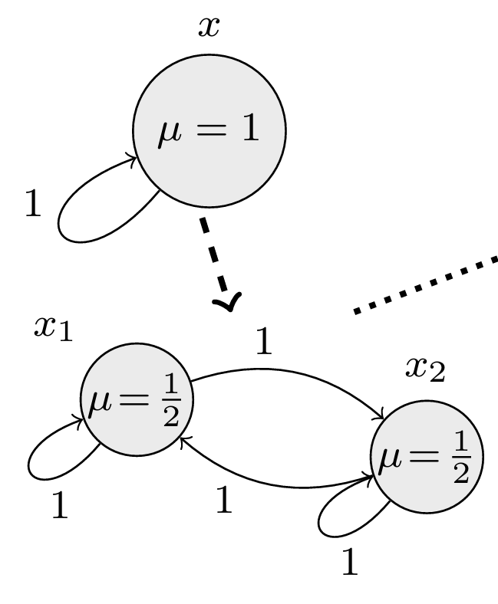
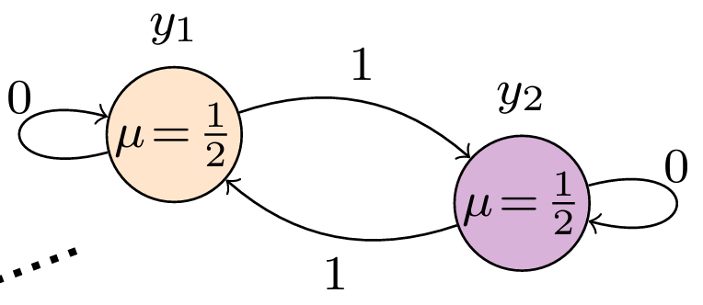
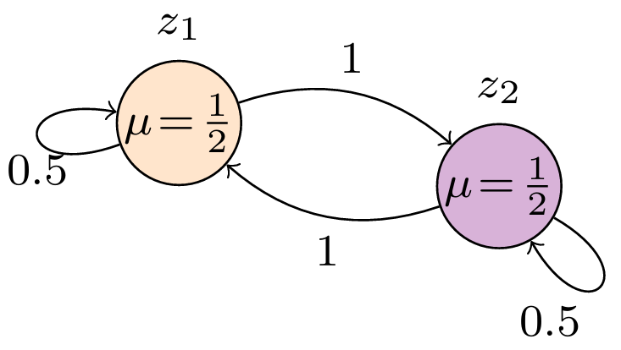

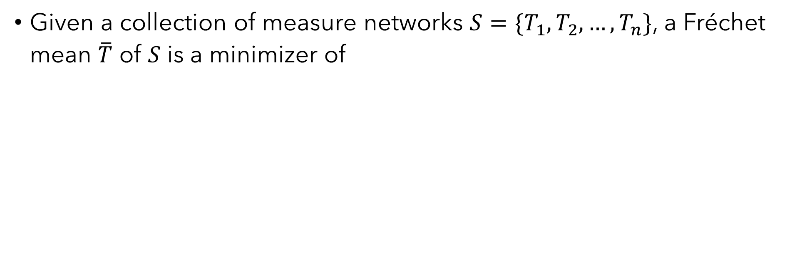

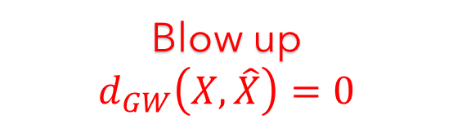


Fréchet Mean
One-to-one correspondence after blow-up & alignment
Geodesics on node relations between corresponding nodes
Given a collection of measure networks $S=\{T_{1},T_{2},…,T_{n}\}$, a Fréchet mean $\overline{T}$ of $S$ is a minimizer of
$$F_{S}\left(\overline{T}\right)=\frac{1}{n}\sum_{i=1}^{n}{d_{GW}(T_{i}, \overline{T})}$$
Chowdhury & Needham 2020
$$X$$
$$Y$$
Fréchet mean
Align
Blow up
$$d_{GW}\left(X, \hat{X}\right)=0$$
$$\hat{X}$$

Slide 14
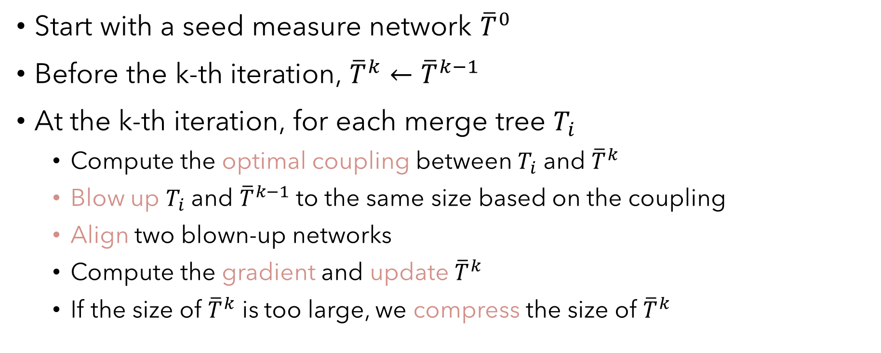
Fréchet Mean for Merge Trees
Start with a seed measure network ${\overline{T}}^{0}$
Before the k-th iteration, ${\overline{T}}^{k}←{\overline{T}}^{k−1}$
At the k-th iteration, for each merge tree $T_{i}$
  Compute the optimal coupling between $T_{i}$ and ${\overline{T}}^{k}$
  Blow up $T_{i}$ and ${\overline{T}}^{k−1}$ to the same size based on the coupling
  Align two blown-up networks
  Compute the gradient and update ${\overline{T}}^{k}$
  If the size of ${\overline{T}}^{k}$ is too large, we compress the size of ${\overline{T}}^{k}$

Slide 15
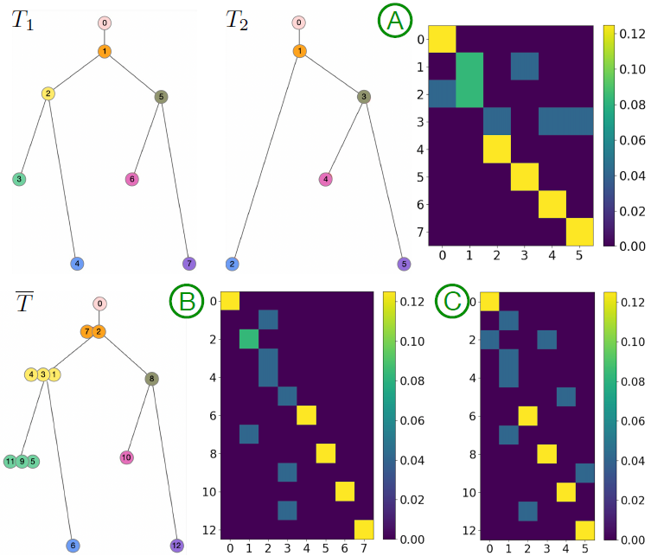



Ideally, each row in $C(\overline{T},T_{1})$ should have exactly one nonzero entry
If multiple nonzero entries exist in a row, we keep the one with the highest probability
$$C(\overline{T},T_{1})$$
$$C(\overline{T},T_{2})$$

Slide 16

Vectorizing Merge Trees
Compute the optimal coupling between $T_{i}$ and ${\overline{T}}^{k}$
Blow up $T_{i}$ to $\hat{T_{i}}$at the same size of ${\overline{T}}^{k}$
  There is (theoretically) one-to-one node alignment between $\hat{T_{i}}$and ${\overline{T}}^{k}$
  Therefore, we have one-to-one node alignment between every pair of $\hat{T_{i}}$ and $\hat{T_{j}}$
Flattened pairwise distance matrix of $\hat{T_{i}}$ as the vector of the merge tree $T_{i}$
  All $\hat{T_{i}}$ are in the same size as $\overline{T}$
  Each dimension of the vector has structural correspondences

Slide 17
Matrix Sketching
Column Subset Selection
  Iterative Feature Selection (IFS) and Length Squared Sampling (LSS)
  Key idea: selecting instances from the original dataset as basis
  Advantage: basis as representative merge trees of the dataset

Slide 18
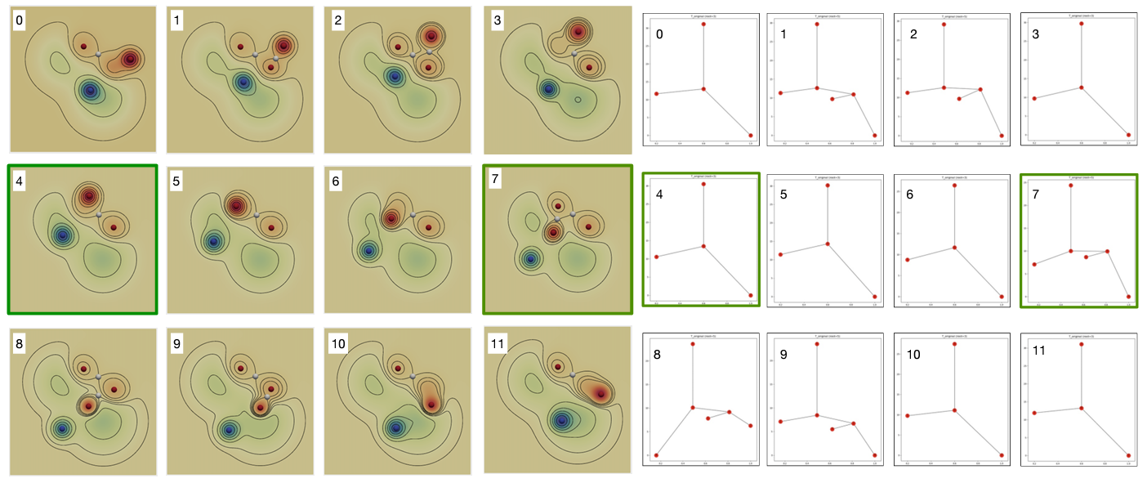
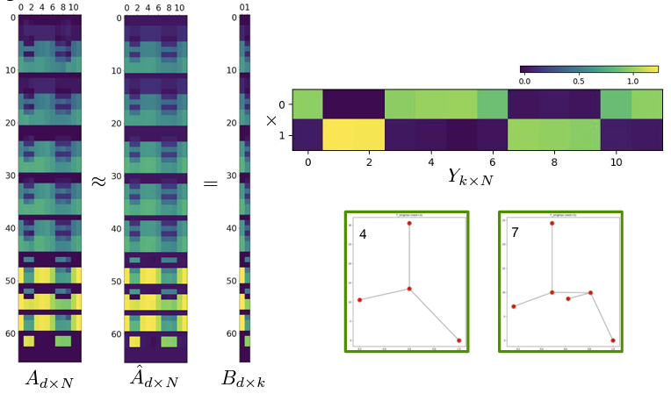
Results: Moving Gaussian
Coefficient matrix
Basis trees

Slide 19
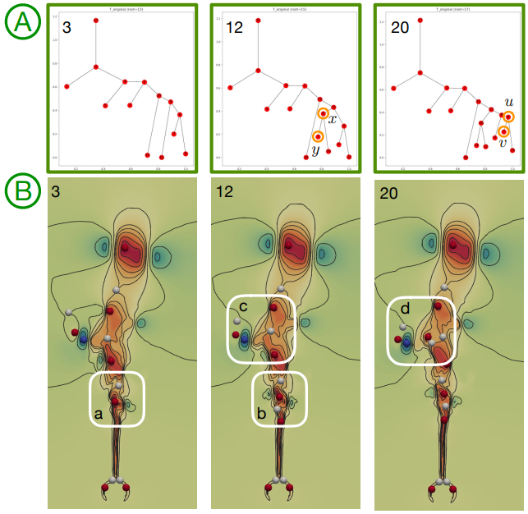
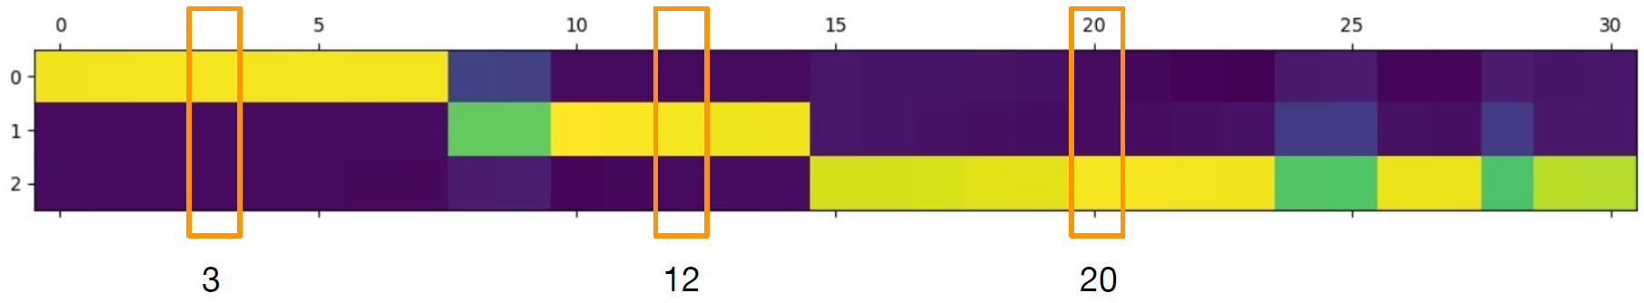
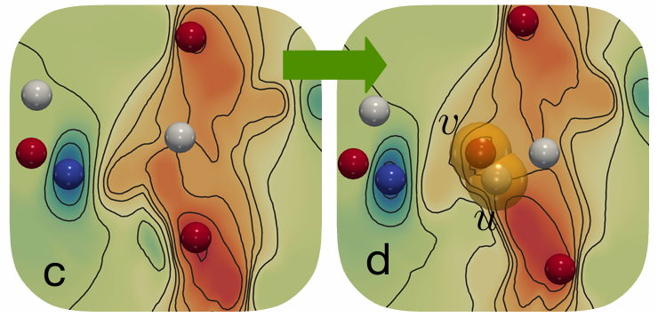
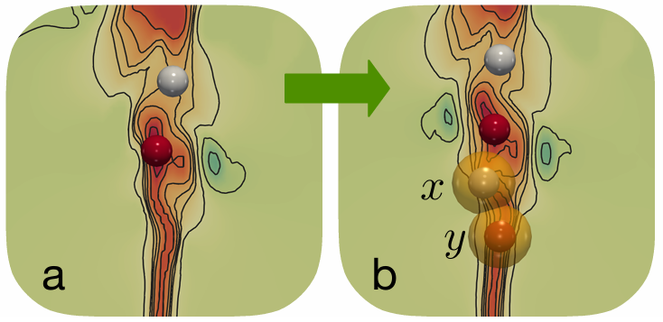

Results: Heated Cylinder
$$T_{0}→T_{7}$$
Coefficient matrix (Column Subset Selection, IFS)

Slide 20
Conclusion
A new distance between merge trees: Gromov-Wasserstein distance
A novel framework to apply matrix sketching to merge trees
  Vectorization of merge trees
  Finding representatives of data
  Identifying modes of physical phenomena

Slide 21
Flexible Topology Tracking Using Partial Optimal Transport
Mingzhe Li, Xinyuan Yan, Lin Yan, Tom Needham, Bei Wang
in IEEE Transactions on Visualization and Computer Graphics (TVCG), 2025

Slide 22

hurricane trajectory
feature tracking
Pipeline:
Extract features from scalar fields
Match features between adjacent time steps
Concatenate matchings to trajectories
Time-varying dataset for Isabel Hurricane

Slide 23
Contribution
A flexible framework to compare merge trees and to track topological features using partial optimal transport
  encoding intrinsic and extrinsic information in the comparison
  allowing partial matching between features
  providing probabilistic tracking results

Slide 24

Attributed Measure Network
Merge tree $T=(V, p, W, A)$
  $V$: a set of nodes
  $p$: a probability distribution on $V$
  $W$: pairwise relation between nodes
  $A$: geometric location of nodes

Slide 25








Wasserstein Distance
  $d_{2}^{W}{\left(T_{1},T_{2}\right)}^{2}= \min_{C}{\sum_{i, j}{d_{A}{\left(a_{i}, b_{j}\right)}^{2}C_{i, j} }}$
  $d_{A}{\left(a_{i}, b_{j}\right)}^{2}$ : Squared Euclidean Distance between points
  Matching faraway points leads to high cost
Kantorovich 1939
$$a_{i}=(1.1, 3.0)$$
$$d_{A}{\left(a_{i}, b_{j}\right)}^{2}$$
$$={\left(1.1 −0.9\right)}^{2}+{\left(3.0 −1.2\right)}^{2}$$
$$=3.28$$
$$i$$
$$b_{j}=(0.9, 1.2)$$
$$j$$

Slide 26










Gromov-Wasserstein Distance
  $d_{2}^{GW}{\left(T_{1},T_{2}\right)}^{2}= \min_{C}{\sum_{i, j, k, l}{ {\left|W_{1}\left(i, k\right) −W_{2}\left(j, l\right)\right|}^{2}{ C}_{i, j}C_{k, l} }}$
  $W$: shortest path distance in merge trees
  ${\left|W_{1}\left(i, k\right) −W_{2}\left(j, l\right)\right|}^{2}$: distortion of node relations
  The optimal coupling minimizes the structure distortion between merge trees
$$k$$
$$i$$
${\left|W_{1}\left(i,k\right)−W_{2}\left(j, l\right)\right|}^{2}$
$$={\left(1.8 −1.3\right)}^{2}=0.25$$
$$l$$
Mémoli 2011
$$W_{1}\left(i, k\right)=1.8$$
$$W_{2}\left(j, l\right)=1.3$$
$$j$$

Slide 27



Fused Gromov-Wasserstein (FGW) Distance
  $d_{2}^{FGW}{\left(T_{1},T_{2}\right)}^{2}=\min_{C}{\sum_{i, j, k, l}{\left[\left(1−α\right)d_{A}{\left(a_{i}, b_{j}\right)}^{2}+ α{\left|W_{1}\left(i, k\right)−W_{2}\left(j, l\right)\right|}^{2}\right]C_{i,j}C_{k,l} }}$
  Combination of Wasserstein distance and GW distance
  $α$: balance hyperparameter
Vayer et al. 2019
$d_{A}{\left(a_{i}, b_{j}\right)}^{2}$: geometric location
${\left|W_{1}\left(i, k\right)−W_{2}\left(j, l\right)\right|}^{2}$: intrinsic tree structure

Slide 28



Partial Optimal Transport
$$m=0.8$$
Optimal Transport forces a full probabilistic matching.
  $\sum_{i,j}{C_{i,j}=1}$
Partial Optimal Transport allows certain probability to be ignored.
  $\sum_{i,j}{C_{i,j}=m (0<m≤1)}$
  More robust to noise
Chapel et al. 2020

Slide 29


Partial Fused Gromov-Wasserstein (pFGW) Distance
We have
$$d_{2}^{pFGW}{\left(T_{1},T_{2}\right)}^{2}=\min_{C}{\sum_{i, j, k, l}{\left[\left(1−α\right)d_{A}{\left(a_{i}, b_{j}\right)}^{2}+ α{\left|W_{1}\left(i, k\right)−W_{2}\left(j, l\right)\right|}^{2}\right]C_{i,j}C_{k,l} }}$$
where $C$ is restricted by
  $\sum_{i,j}{C_{i,j}=m (0<m≤1)}$
  $C1_{|V_{2}|}≤p_{1}$
  $C^{T}1_{|V_{1}|}≤p_{2}$
geometric location
intrinsic tree structure
partial optimal transport
$$1_{n}={\left(1, 1, …, 1\right)}^{T}∈R^{n}$$
Refer to the paper for more details…

Slide 30




Results
T
T
Vortex Street
Heated Cylinder

Slide 31

Probabilistic Feature Tracking
split
merge
merge
split

Slide 32
Conclusion
A flexible framework to track topological features using merge trees
  pFGW distance between merge trees
  Merge tree node matching for feature tracking
  Probabilistic feature tracking graphs
    Visualizing uncertainty of matching
    Indicating feature merge/split events
New stability results for GW distance between merge trees
  See paper for details

Slide 33
Tracking Low-Level Cloud Systems Based on Topology
Mingzhe Li, Dwaipayan Chatterjee, Franziska Glassmeier, Fabian Senf, Bei Wang

Slide 34


Background
Data: Satellite image of clouds
Scalar field: optical thickness
  High-value regions --> thick clouds
Task: tracking cloud systems
Difficulty:
  Ambiguous definitions of clouds
  High data complexity in terms of topology
  Frequent feature appearance/disappearance
min
max

Slide 35


Background: Cloud Detection
Cloud object
Contribution: geometrically close cloud objects are considered as a whole system, which we call a cloud system.

Slide 36


Contribution: Merge Tree for Anchor Points
Merge Tree
Maxima as anchor points for cloud object

Slide 37

Tracking Anchor Points
Framework: pFGW distance
- location as node attributes
- tree distance as node relations
* Encoding locality of local maxima (within the same cloud object)
- partial OT for flexible matching

Slide 38

Tracking Anchor Points for Cloud Systems

Slide 39

Tracking Results: Shallow Cumulus Clouds

Slide 40

Tracking Results: Stratocumulus Clouds

Slide 41

Comparing with State-of-the-art (Shallow Cumulus)
Scalar field
ours
Region overlap
Centroid Tracking

Slide 42
Conclusion
Topology-based Tracking Framework for Cloud Tracking
  superlevel set for cloud objects/systems
  pFGW distance as measure
    Optimal coupling for critical point matching
  local maxima as anchor points for cloud objects/systems

Slide 43
Comparing Morse Complexes Using Optimal Transport
Mingzhe Li, Carson Storm, Austin Yang Li, Tom Needham, Bei Wang
In IEEE Visualization and Visual Analytics (VIS) Short Paper, 2023

Slide 44

Morse Complex and Morse Graph
Peak (Maxima)
Saddle
Pit (Minima)
2D Scalar Field
Morse Complex (Descending Manifold)

Slide 45



Morse Graph
Morse Complex
(Descending Manifold)
1D Skeleton
Morse Graph
OT Distances
3

Slide 46










Optimal Transport (OT) Distances
$$G_{1}=(V_{1}, p_{1}, W_{1})$$
Coupling Matrix
$$C∈R^{{|V}_{1}|×|V_{2}|}$$
x₁
y₁
x₁
$$\sum_{i∈V_{1}}{p1(x_{i})}=1$$
Optimal Transport
$$G_{2}=(V_{2}, p_{2}, W_{2})$$
$$\sum_{j∈V_{2}}{p2(y_{j})}=1$$
y₁
$$W_{1},W_{2}:$$
Node relation
- Nonzero entry

Slide 47






Wasserstein Distance
  $d_{q}^{W}{\left(G_{1},G_{2}\right)}^{2}= \min_{C}{\sum_{i, j}{d_{A}{\left(a_{i}, b_{j}\right)}^{2}C_{i, j} }}$
  $d_{A}{\left(a_{i}, b_{j}\right)}^{2}$ : Squared Euclidean Distance between points
  Matching faraway points leads to high cost
$$a_{i}=(1.1, 3.0)$$
$$i$$
$$b_{j}=(0.0, 2.7)$$
$$j$$
$$d_{A}{\left(a_{i}, b_{j}\right)}^{2}$$
$$={\left(1.1 −0.0\right)}^{2}+{\left(3.0 −2.7\right)}^{2}$$
$$=1.30$$

Slide 48








Gromov-Wasserstein Distance (GW)
  $d_{q}^{GW}{\left(G_{1},G_{2}\right)}^{2}= \min_{C}{\sum_{i, j, k, l}{ {\left|W_{1}\left(i, k\right) −W_{2}\left(j, l\right)\right|}^{2}{ C}_{i, j}C_{k, l} }}$
  $W_{1}\left(i, k\right)$ & $W_{2}\left(j, l\right)$: shortest path between nodes
  Matched nodes in two networks should have similar intrinsic graph structure
$$W_{2}\left(j, l\right)=0.9$$
$$i$$
$$W_{1}\left(i, k\right)=1.8$$
$$l$$
$$j$$
$$k$$
${\left|W_{1}\left(i,k\right)−W_{2}\left(j, l\right)\right|}^{2}$
$$={\left(1.8 −0.9\right)}^{2}=0.81$$

Slide 49












Fused Gromov-Wasserstein Distance (FGW)
  $d_{q}^{FGW}{\left(G_{1},G_{2}\right)}^{2}=\min_{C}{\sum_{i, j, k, l}{\left[\left(1−α\right)d_{A}{\left(a_{i}, b_{j}\right)}^{2}+ α{\left|W_{1}\left(i, k\right)−W_{2}\left(j, l\right)\right|}^{2}\right]C_{i,j}C_{k,l} }}$
  Combination of Wasserstein distance and GW distance
  $α$: balance hyperparameter
$d_{A}{\left(a_{i}, b_{j}\right)}^{2}$: geometric location
${\left|W_{1}\left(i, k\right)−W_{2}\left(j, l\right)\right|}^{2}$: intrinsic graph structure
$$a_{i}=(1.1, 3.0)$$
$$b_{j}=(0.0, 2.7)$$
$$W_{1}\left(i, k\right)=1.8$$
$$W_{2}\left(j, l\right)=0.9$$
$$i$$
$$j$$
$$i$$
$$l$$
$$k$$
$$j$$
+

Slide 50



Partial Optimal Transport (pOT)
Optimal Transport forces a full probability matching.
  $\sum_{i,j}{C_{i,j}=1}$
Partial Optimal Transport allows certain probability to be ignored.
  $\sum_{i,j}{C_{i,j}=m (0<m≤1)}$
  More robust to noise
Distances
  Partial Wasserstein (pW)
  Partial Gromov-Wasserstein (pGW)
  Partial Fused Gromov-Wasserstein (pFGW)
Noise

Slide 51





Target
Geometric location
Graph structure
Geometric location +
Graph structure
Source
Wasserstein
GW
FGW
OT
pW
pGW
pFGW
Partial OT

Slide 52



Result – Feature Correspondence
Dataset: Heated Cylinder ^{[1]}
Source
Target (pFGW)
[1]. Computer graphics laboratory. https://cgl.ethz.ch/research/visualization/data.php.

Slide 53

Detecting Structure Similarities – Heated Cylindner

Slide 54

Detecting Structure Similarities – Heated Cylindner

Slide 55






Classification

Slide 56
Conclusion
A class of OT-based distances between Morse graphs
  serve as a type of Morse-complex comparative measures
  can encode different information
  can be robust to noise: partial OT

Slide 57
Summary

Slide 58

Summary
My webpage
(preprints available)
https://mingzhefluorite.github.io
Optimal Transport: useful tool for comparing graph-based topological descriptors
  Theoretical foundation + Easy-to-compute
  Output: structure correspondence and similarity measure
  Different encodings / variations
    Gromov-Wasserstein Distance: intra-graph relations
    Wasserstein Distance: node attributes
    Partial OT: flexibility in matching
    More to explore…

Slide 59







Collaborators and Grants
My webpage
(preprints available)
https://mingzhefluorite.github.io
Bei Wang
Tom Needham
Lin Yan
Xinyuan Yan
Sourabh Palande
Grants
  NSF IIS-2145499, IIS-1910733, DMS-2107808
  DOE DE-SC0021015
And more:
C. Storm, A. Y. Li
D. Chatterjee, F. Glassmeier, F. Senf

Slide 60
References
H. Carr, O. R¨ubel, and G. H. Weber. Distributed hierarchical contour trees. In 2022 IEEE 12th Symposium on Large Data Analysis and Visualization (LDAV), pages 1–10, New York, 2022. IEEE.
H. Carr, J. Snoeyink, and M. van de Panne. Flexible isosurfaces: Simplifying and displaying scalar topology using thecontour tree. Computational Geometry: Theory and Applications, 43(1):42–58, 2010.
L. Chapel, M. Z. Alaya, and G. Gasso. Partial optimal tranport with applications on positive-unlabeled learning. Advances in Neural Information Processing Systems, 33:2903–2913, 2020.
S. Chowdhury and T. Needham. Gromov-Wasserstein averaging in a Riemannian framework. Proceedings of the IEEE/CVF Conference on Computer Vision and Pattern Recognition Workshops, pages 842–843, 2020.
S. Chowdhury and T. Needham. Generalized spectral clustering via Gromov-Wasserstein learning. Proceedings of The 24th International Conference on Artificial Intelligence and Statistics, PMLR, 130:712–720, 2021.
P. Hristov, G. H. Weber, H. Carr, O. R¨ubel, and J. Ahrens. Data parallel hypersweeps for in situ topological analysis. In 2020 IEEE 10th Symposium on Large Data Analysis and Visualization (LDAV), pages 12–21, New York, 2020. IEEE.
M. Li, H. Carr, O. R¨ubel, B. Wang, and G. H. Weber. Distributed augmentation, hypersweeps, and branch decomposition of contour trees for scientific exploration. IEEE Transactions on Visualization and Computer Graphics, pages 1–11, 2024.

Slide 61
References
F. Mémoli. Gromov-Wasserstein distances and the metric approach to object matching. Foundations of Computational Mathematics, 11(4):417–487, 2011.
M. Pont, J. Vidal, J. Delon, and J. Tierny. Wasserstein distances, geodesics and barycenters of merge trees. IEEE Transactions on Visualization and Computer Graphics, 2021.
G. Reeb. Sur les points singuliers d’une forme de pfaff completement intergrable ou d’une fonction numerique (on the singular points of a complete integral pfaff form or of a numerical function). Comptes Rendus Acad. Science Paris, 222:847–849, 1946.
T. Vayer, N. Courty, R. Tavenard, and R. Flamary. Optimal transport for structured data with application on graphs. International Conference on Machine Learning, pages 6275–6284, 2019.
H. Xu, D. Luo, H. Zha, and L. Carin. Gromov-Wasserstein learning for graph matching and node embedding. International Conference on Machine Learning, pages 6932–6941, 2019.
L. Yan, T. B. Masood, F. Rasheed, I. Hotz, and B. Wang. Geometry-aware merge tree comparisons for time-varying datawith interleaving distances. IEEE Transactions on Visualization and Computer Graphics (TVCG), 2022.

